Slide 1
Discover the role of Python in space exploration
Abhigya Verma Microsoft Learn Student Ambassador Alpha

Slide 2
Session 1: Introduction to Python for space exploration Get an introduction to the types of space exploration problems that Python and data science can influence.
Abhigya Verma Microsoft Learn Student Ambassador Alpha

Slide 3
Learning objectives
How code and data science plays a role in space exploration
Where to find STEM resources for learning more
Prerequisites
None

Slide 4
Discover the opportunities of the Artemis Program
NASA's new lunar exploration program
All lunar activities
Mission to land the first woman and the next man on the Moon by 2024

Slide 5
What innovations are happening?
Exploration Ground Systems
Space Launch System
Orion
Gateway
Human Landing Systems
Artemis Generation spacesuits

Slide 6
Understand continued research goals of space exploration
New Researches get added to the program
For e.g. moon rock’s study

Slide 7
Dive into STEM through the opportunities of NASA
The NASA STEM team's goal is to engage the next generation of scientists and contributors.

Slide 8
NASA STEM programs
There are three programs that have recently launched for K-12 students:
Next Moon Step challenge: Grades K-12
NASA STEM @ Home: Grades K-4
Next Gen Stem: Moon to Mars: K-12
There are a number of programs targeted to higher education students as well, which can be found on the NASA STEM Engagement website.

Slide 9
Goal of NASA STEM Programs
Inspire people to look deeper into what makes programs such as Artemis possible.
Solutions we can design to improve our Earth, societies, and futures, have endless possibilities.

Slide 10
Use code and data science practices to solve space exploration problems
Visual Studio Code
Microsoft Azure

Slide 11
In this module, you learned about NASA and some of their future missions. You also learned about how NASA uses STEM to solve some of their difficult problems and what learning STEM can do for you.

Slide 12
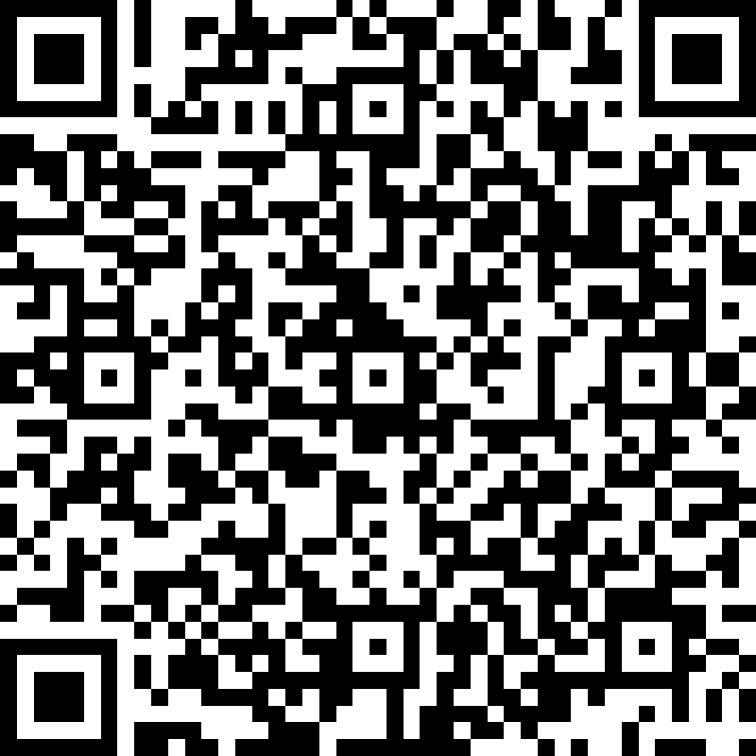
Quiz Time
https://forms.office.com/r/3yWvxssy8f

Slide 13
Session 2: Install coding tools for Python development Learn about what coding is and install tools to help you code.
Abhigya Verma Microsoft Learn Student Ambassador Alpha

Slide 14
Session 3: Write basic Python in Notebooks in Visual Studio Code Learn the basics of Python.
Abhigya Verma Microsoft Learn Student Ambassador Alpha

Slide 15
Session 4: Code control statements in Python Learn more advanced topics of Python.
Abhigya Verma Microsoft Learn Student Ambassador Alpha

Slide 16
Session 5: Count the number of Moon rocks by type using Python Use Python and Visual Studio Code to make a simple program to count the number of each type of space rock.
Abhigya Verma Microsoft Learn Student Ambassador Alpha

Slide 17
THANK YOU SO MUCH!!!

